Slide 1
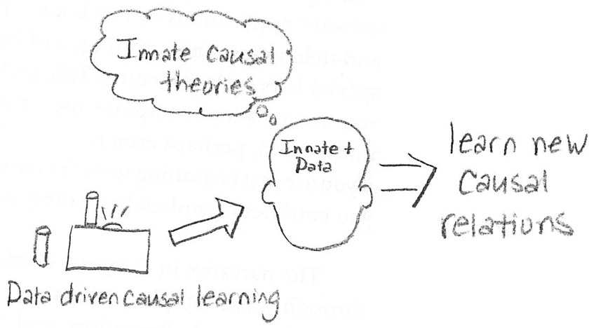
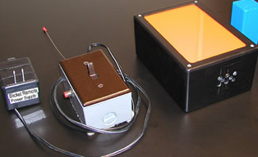
Gopnik, Sobel, Schulz, & Glymour (2001) Causal learning mechanisms in very young children.
Theory
Children build causal representations of how things work in the world.
  Substantive principal (top-down inferences)
  Formal principal (inferences not dependent on prior knowledge)
People infer causal relations when one event consistently follows another.
  Screening off is the name given when one event, usually unnoticed, produces the illusion of a causal relationship between two other events that in actuality are not related.
Research question: When causal inferences is possible from patterns of data, will children draw genuinely causal conclusions?
Key insight
Strengths and weaknesses
Methodology improves on past work with kids because it does not require the use of meta-cognitive skills to demonstrate causal learning.
In experiment 3, it is not possible to determine whether children who removed both blocks in succession as opposed to
simultaneously initially
understood the causal
nature of the experiment.
Methods and findings
2-4 yr old children were told “blinkets make the machine go.”
One-cause tasks: 2 blocks were placed on detector individually and simultaneously. Block A always lit up detector, block B never did.
Two-cause tasks: 2 blocks were placed on detector individually. Block A always lit up detector, block B did only 2/3 of the time.
In one-cause tasks, children correctly stated that block A was a blinket and block B was not. In two-cause tasks, both block were identified as blinkets.

